Slide 1
DSC530-T302 Exploratory Data Analysis
Final Project
Katie Briggs

Slide 2
The Data Set Suicide Statistics
The dataset that I was from the World Health Organization’s Suicide Statistics.
There are six variables:
Two variables are discrete, and four variables are continuous.
Country, where the documented suicide took place.
Year, 1979 to 2016 when the suicide took place.
Sex, male and female
Age, age group of the person that committed suicide
Suicide No, Number of Suicides
Population, all living people within the country
Data set can be found: https://www.kaggle.com/szamil/who-suicide-statistics#who_suicide_statistics.csv

Slide 3
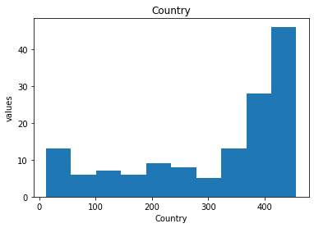
Country Variable
The highest numbers were led by:
1) United Stated
2) Romania
3) Sweden
Note: Assisted suicides are legal in Sweden.
4) Iceland
5) United Kingdom

Slide 4
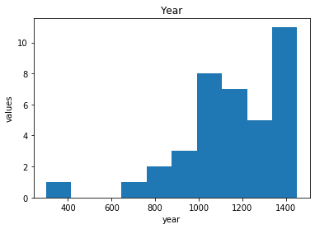
Year Variable
The highest amount of suicides happened in:
1) 2009
2) 2002
3) 2001
4) 2008
5) 2003

Slide 5
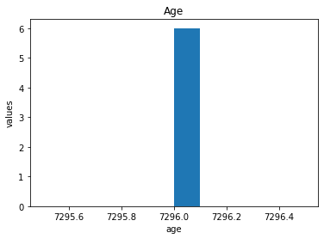
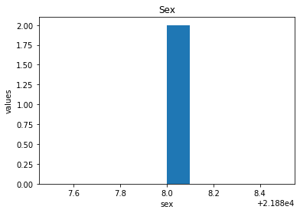
Age and Sex
Ages were entered in group
5 to 14
15 to 24 – This was the most common age group for suicide
25 to 34
35 to 54
55 to 74
75+
Sex was grouped by Male and Female.

Slide 6
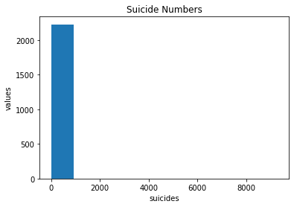
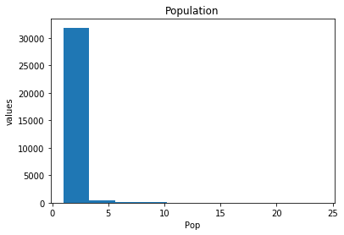
Suicide Numbers and Population
Suicide Numbers
41.5k were valid suicides that were documented
Population
Max of 43 million people

Slide 7
Mean, Variance and Standard Deviation
The Mean, Var, and Std for Country are as follows:
Mean = 310.468085106383,
Var = 20741.86504559269,
Std = 144.02036330183552
The Mean, Var, and Std for Year are as follows:
Mean = 1152.0
Var = 57467.67567567567
Std = 239.72416581495423

Slide 8
Mean, Variance and Standard Deviation Cont.
The Mean, Var, and Std for Sex are as follows:
Mean = 21888.0
Var = 0.0
Std = 0.0
The Mean, Var, and Std for Age are as follows:
Mean = 7296.0
Var = 0.0,
Std = 0.0

Slide 9
Mean, Variance and Standard Deviation Cont.
The Mean, Var, and Std for Suicide Number are as follows:
Mean = 18.610488570147915
Var = 46128.08005137324,
Std = 214.77448650008046
The Mean, Var, and Std for Populations are as follows:
Mean = 1.1811708129103857
Var = 0.6375935363618169
Std = 0.7984945437270169

Slide 10
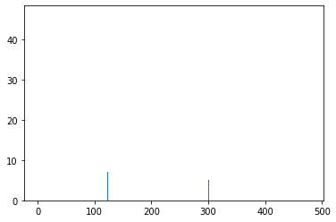
PMF
I created a random number dataframe with integars between 0 and 444. Then calculated the PMF to compare the scenario of Country.
The findings are off by 10.
The pmf created 10 more suicides in a country.

Slide 11
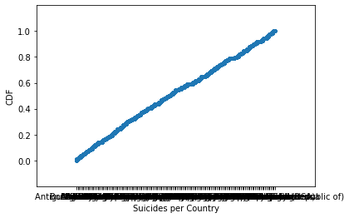
CDF
I chose to do the CDF of the Country Variable.
The line is not as curved and is pretty much a straight line going up.
According to our text, it indicates that the distribution is uniform.

Slide 12
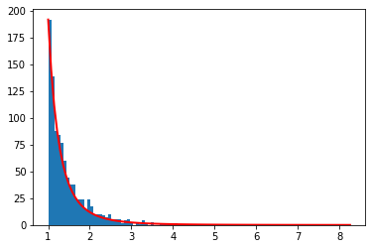
Pareto Distribution
I did random numbers from the country variable and created a GPD.
It demonstrates the tail of suicides committed in the countries.

Slide 13
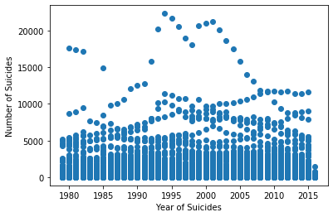
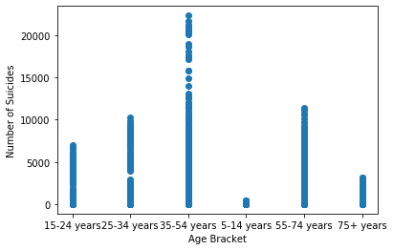
Scatter Plots
I chose to create a scatter plot of Number of Suicides and Year of Suicides. Here I can see that 1995 and 2003 were high percentages of suicides occurred.
I can see from the scatter plot about Age of Suicides that 34 to 54 have that largest bracket of suicides.

